Slide 1
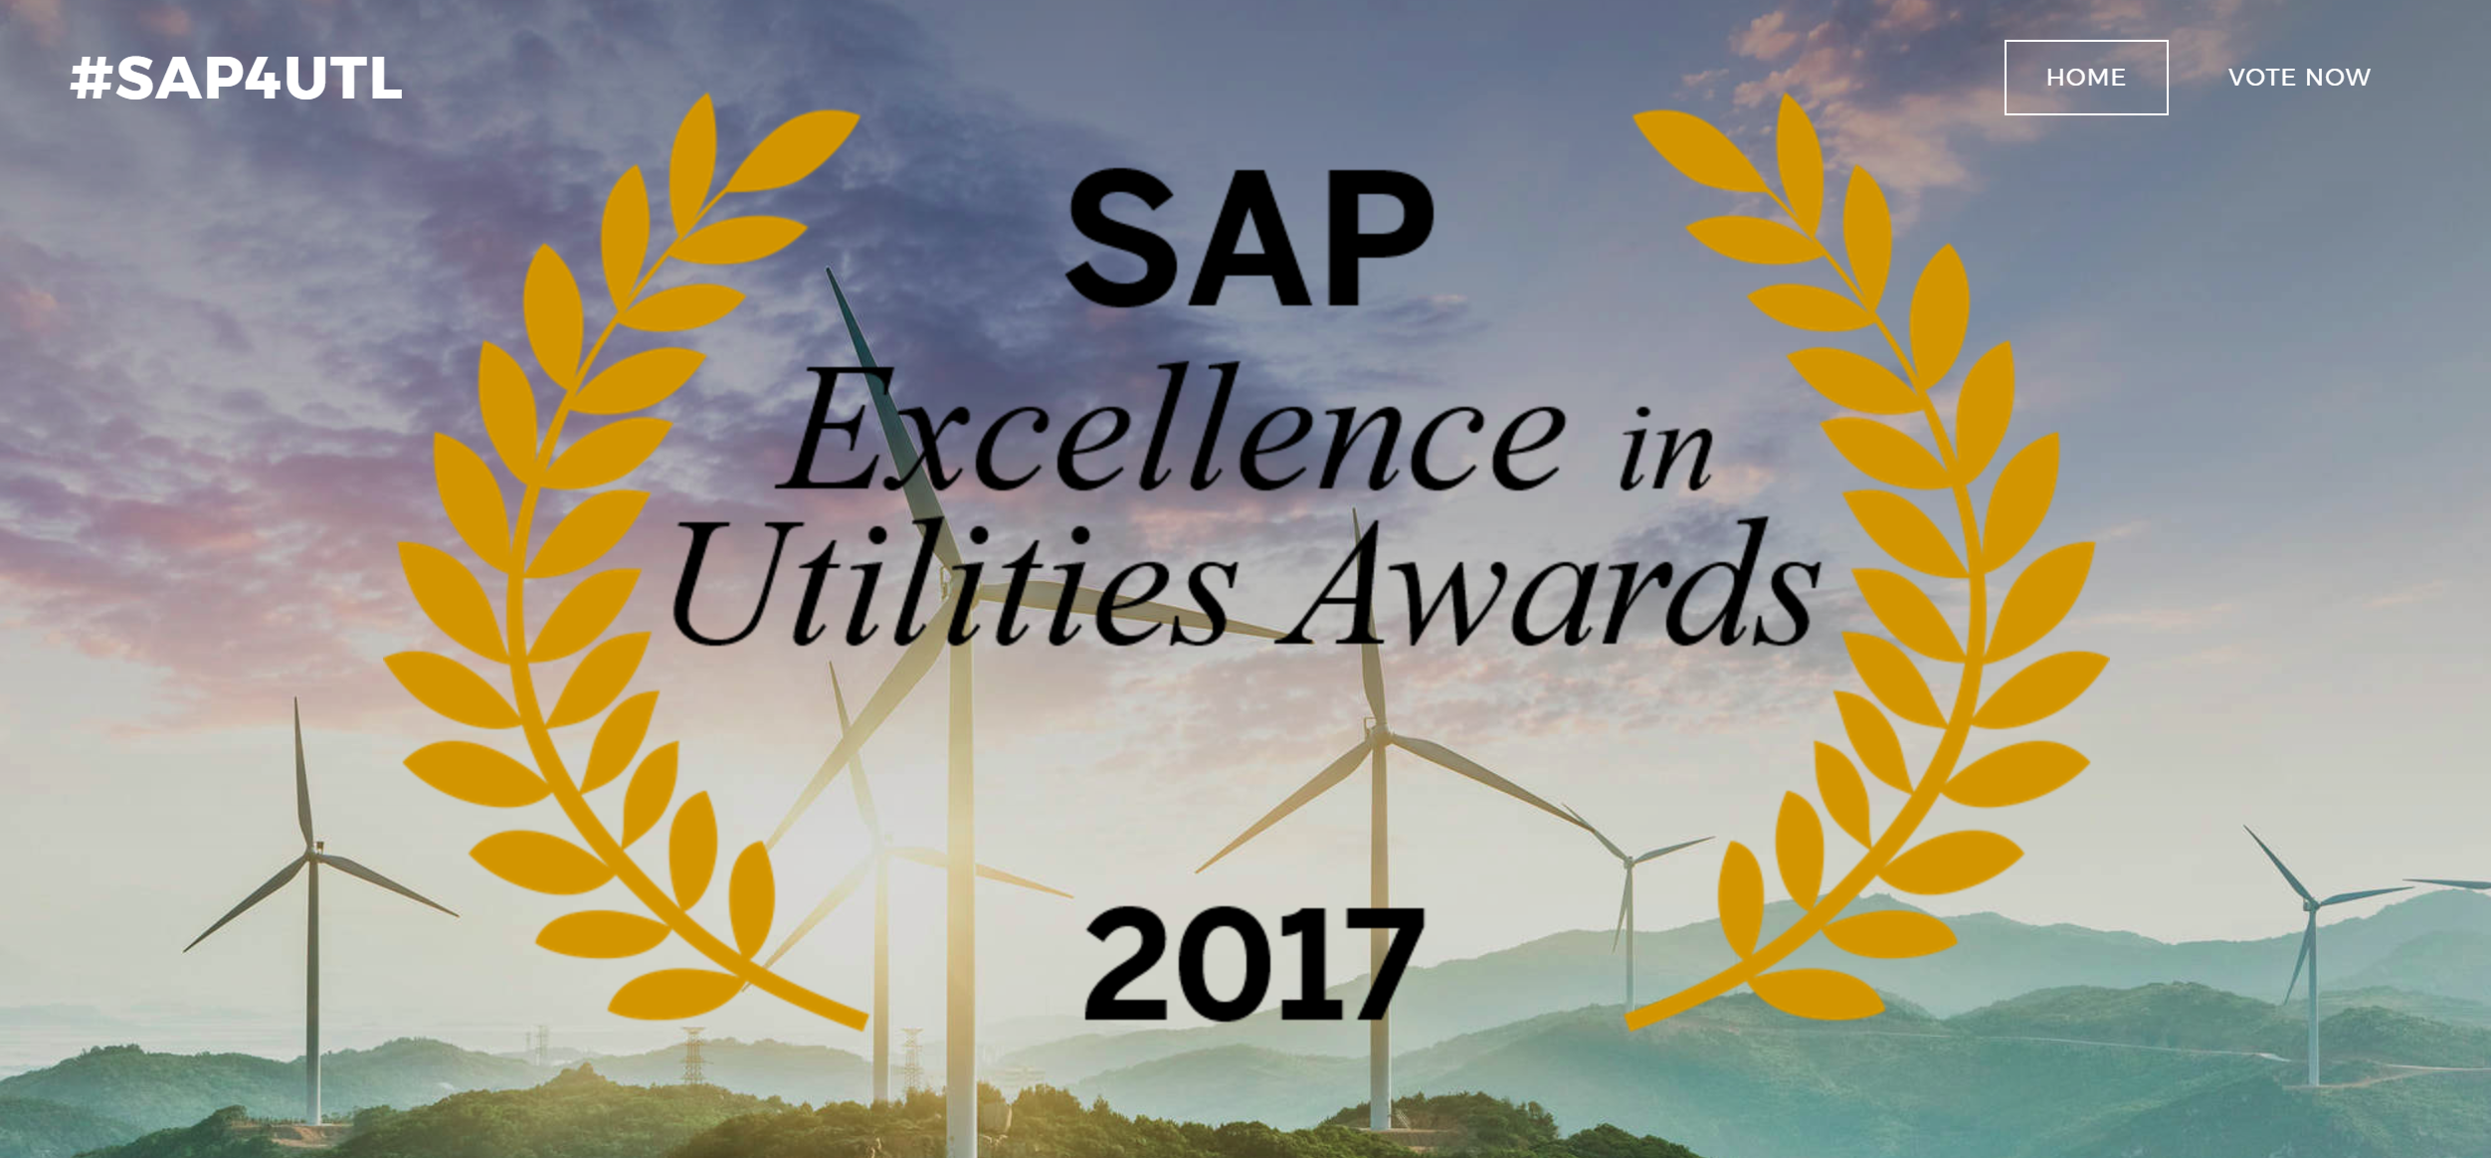
EXCELLENCE IN CUSTOMER

Slide 2
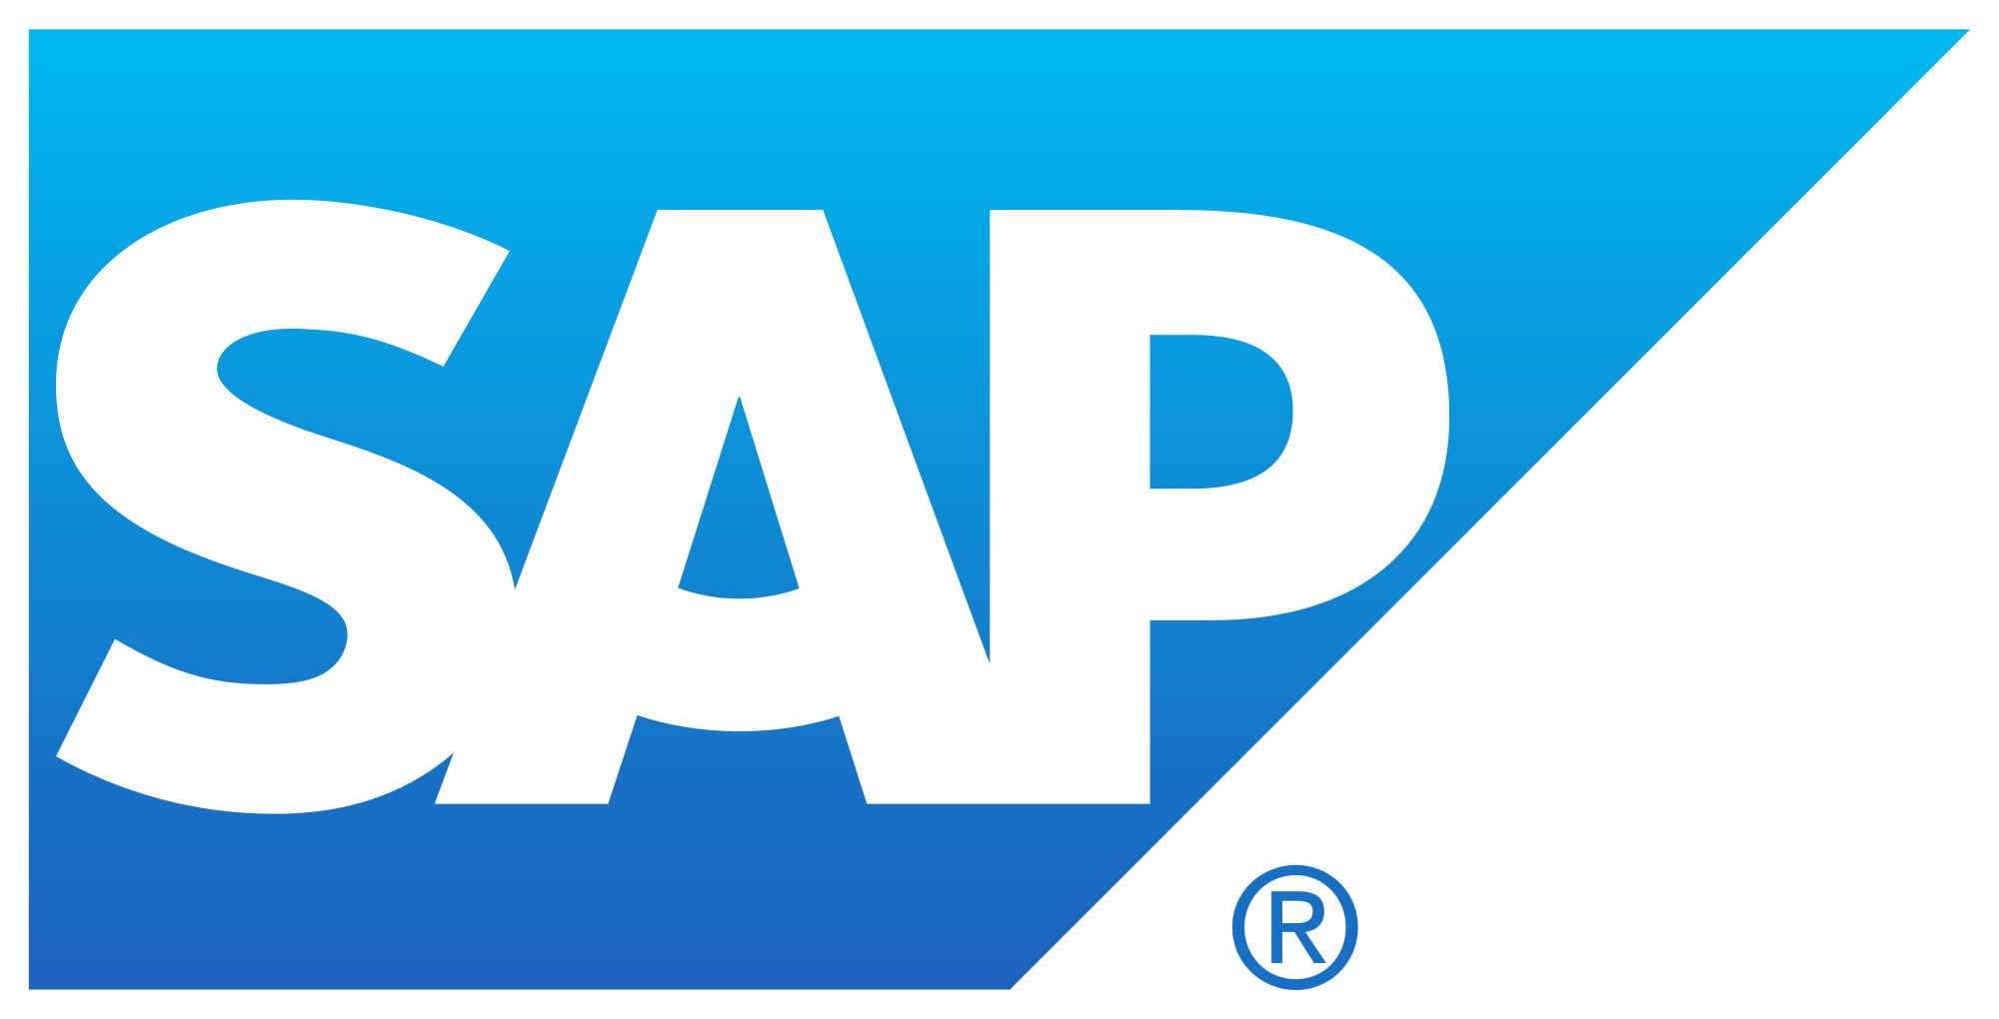
Which project(s) targeted the end user, and how were customers better served?
Location: Fairfax, VA
Number of Employees: ~500
Number of Customers: 1.9 million
Area Served: Washington DC, Virginia
Fairfax Water implemented the SAP Multi-Channel Foundation, ustomer engagement web and mobile platform that provides self-service capabilities and enables real-time two-way communication empowering the customer-utility relationship. This platform provides a 360-degree view of all customer interactions while reducing utility operational cost and maximizes the return on investments. The solution uses SAP Gateway to connnect SAP CIS IS-U and backend systems
What business results were accomplished as a result of innovating with the customer in mind?
Reduced call volume for utility CSRs
Reduced customer care expenses
Reduced overall transactional cost
Provides payment convenience
Minimizes consumption
Quicker outage restoration time
Increased Customer Satisfaction
#SAP4UTL

Slide 3
What business results were accomplished as a result of innovating with the customer in mind?
Location: Akron, OH
Number of Employees: 15,500
Number of Customers: 6 million
Area Served: Ohio, Pennsylvania, West Virginia, Virginia, Maryland, and New Jersey
Project Nexus
FirstEnergy evaluated how they were serving their customers needs and how they can better serve demands in the energy space. As a result, FirstEnergy realized a digital transformation was required to shift their business to address this unserved market. Through a four month-long agile project, FirstEnergy implemented a completely new end-to-end business, delivered on the entire Hybris suite. Through this new digital customer transformation, FirstEnergy has realized a 360 degree view of the customer and can target, market and capture this audience. In addition, FirstEnergy delivers a seamless experience through order tracking and billing experience.
What business results were accomplished as a result of innovating with the customer in mind?
With an internal go-live in May, the team delivered the project on time and on budget. They have successfully migrated their legacy customers over while delivering a digital experience that takes them away from manual spreadsheet billing processes. Both FirstEnergy and the customer now have complete visibility to order fulfillment and billing. This new platform, gives them the capability to instantly shift their business as new markets develop. In addition they have the ability to better understand their customers needs through social engagement and deliver a seamless experience.
#SAP4UTL

Slide 4
What business results were accomplished as a result of innovating with the customer in mind?
Location: Tampa, FL
Number of Employees: 3,200
Number of Customers: 1.5 million
Area Served: Eastern and Central Florida
As described by Gordon Gillette, president and CEO, Tampa Electric, and president of Florida Operations: "The last time we upgraded our customer billing systems, the term “internet” wasn’t even part of the public sphere. “Family Ties” was on TV. The space shuttle program was in full swing. Ronald Reagan was in the White House.“
Needless to say, TECO was running antiquated CIS systems (eCIS and gCIS) and had difficulties supporting new business processes and technologies. With CRB on Hana Teco now can better serve the customers based on their preferences.
What business results were accomplished as a result of innovating with the customer in mind?
Project Highlights
This was the biggest customer service upgrade in three decades for Tampa Electric and People Gas. Converted and loaded 1.5 million contract accounts
Devices (meters and others - through conversion): 848,000 electric devices (791,000 installed) and 812,000 gas devices (767,000 installed)
Electric service area: west central Florida
Gas service area: 14 service divisions throughout Florida
Active users: over 1000
Departments/business areas involved: 37
#SAP4UTL

Slide 5
What business results were accomplished as a result of innovating with the customer in mind?
Location: Washington, DC
Number of Employees: 1,500+
Number of Customers: 1 million+
Area Served: Washington DC, Maryland, and Virginia
Successful implementation of Project Vision that included the following key SAP applications:
• Customer Relationship and Billing (CRB) - Suite on HANA
• SAP Mobile Work Management (MWM)
• SAP Business Intelligence Suite
• Open Text Document Presentment & Archiving
WGL implemented the new Customer Information System (“CIS”) solution that will include all software and services required to implement and support the stated interfaces and traditional CIS functions such as customer service, account management, credit and collections, service orders, meter inventory, usage, billing, service address management, portfolio management, rates, and financial based activities. This new CIS replaced the WGL mainframe customer information system implemented in the 1970’s and related systems that supports all of the traditional utility business functions such as meter reading, billing, payment processing, credit, collections, field requests and service work orders.
What business results were accomplished as a result of innovating with the customer in mind?
Why Now: CIS and MWM replacement is a key enabler to WGL Energy Answers:
• SERVICE: Better Functional fit (36%) vs(90+%) CIS without manual workarounds.
• Performance: Better risk management, the majority of WG consumer services SOX issues are related to the complexity and limitations of the existing CIS environment. old CS processes require manual workarounds, adding complexity and risk.
• Innovation: Cost reductions include eliminating decommissioned systems support, reduced call times with workflows, scripting, and self-service. Cost avoidance include reduced rework with workflows and improved exception processing, eliminating needed uplift & upgrade projects to the existing systems, and improved collections. Revenue enhancement includes reduced bad debt and reduced billing corrections
• Diversity: Original diversity spend goal in RFP was 10%, increase to 16% through testing scope
• Sustainability: Current legacy mainframe is 40 year old, home-grown application. SAP offers readily available resources, planned upgrades and a comprehensive user group community.
#SAP4UTL

